Slide 1
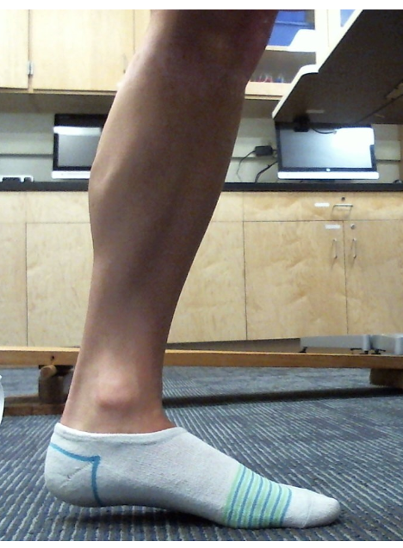
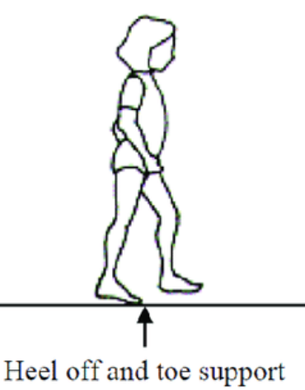
System: Foot
Assume foot not moving nor rotating, so forces and torques balance
Joint Axis: ankle
n_{floor}
W_{body}
n_{floor} = W_{body}

Slide 2
Drag outline to show torque rotation direction the floor force exerts on the foot,
n_{floor} = W_{body}
Dorsiflexion
Plantarflexion

Slide 3
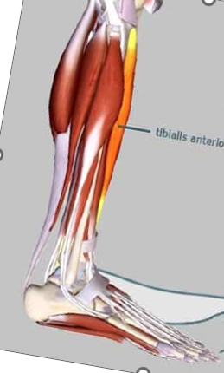
Which muscle provides counter-torque to floor force?
Drag to select
Achilles/calf
Tibialis
Doriflexion
Achilles/calf
Tibialis
Plantar flexion
Drag to show the torque direction each muscle forces exerts?

Slide 4
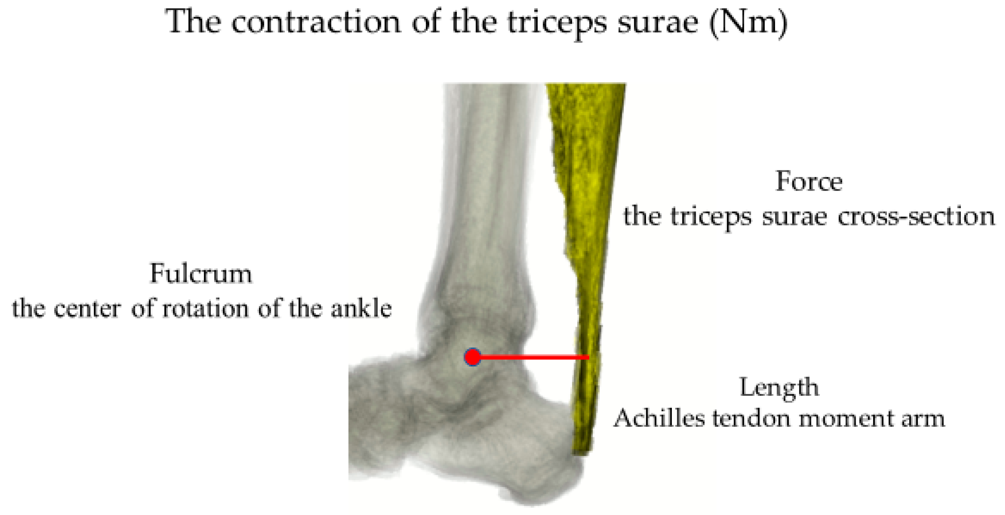
Moment arm is another term for lever arm
https://www.mdpi.com/2076-3417/10/19/6631

Slide 5
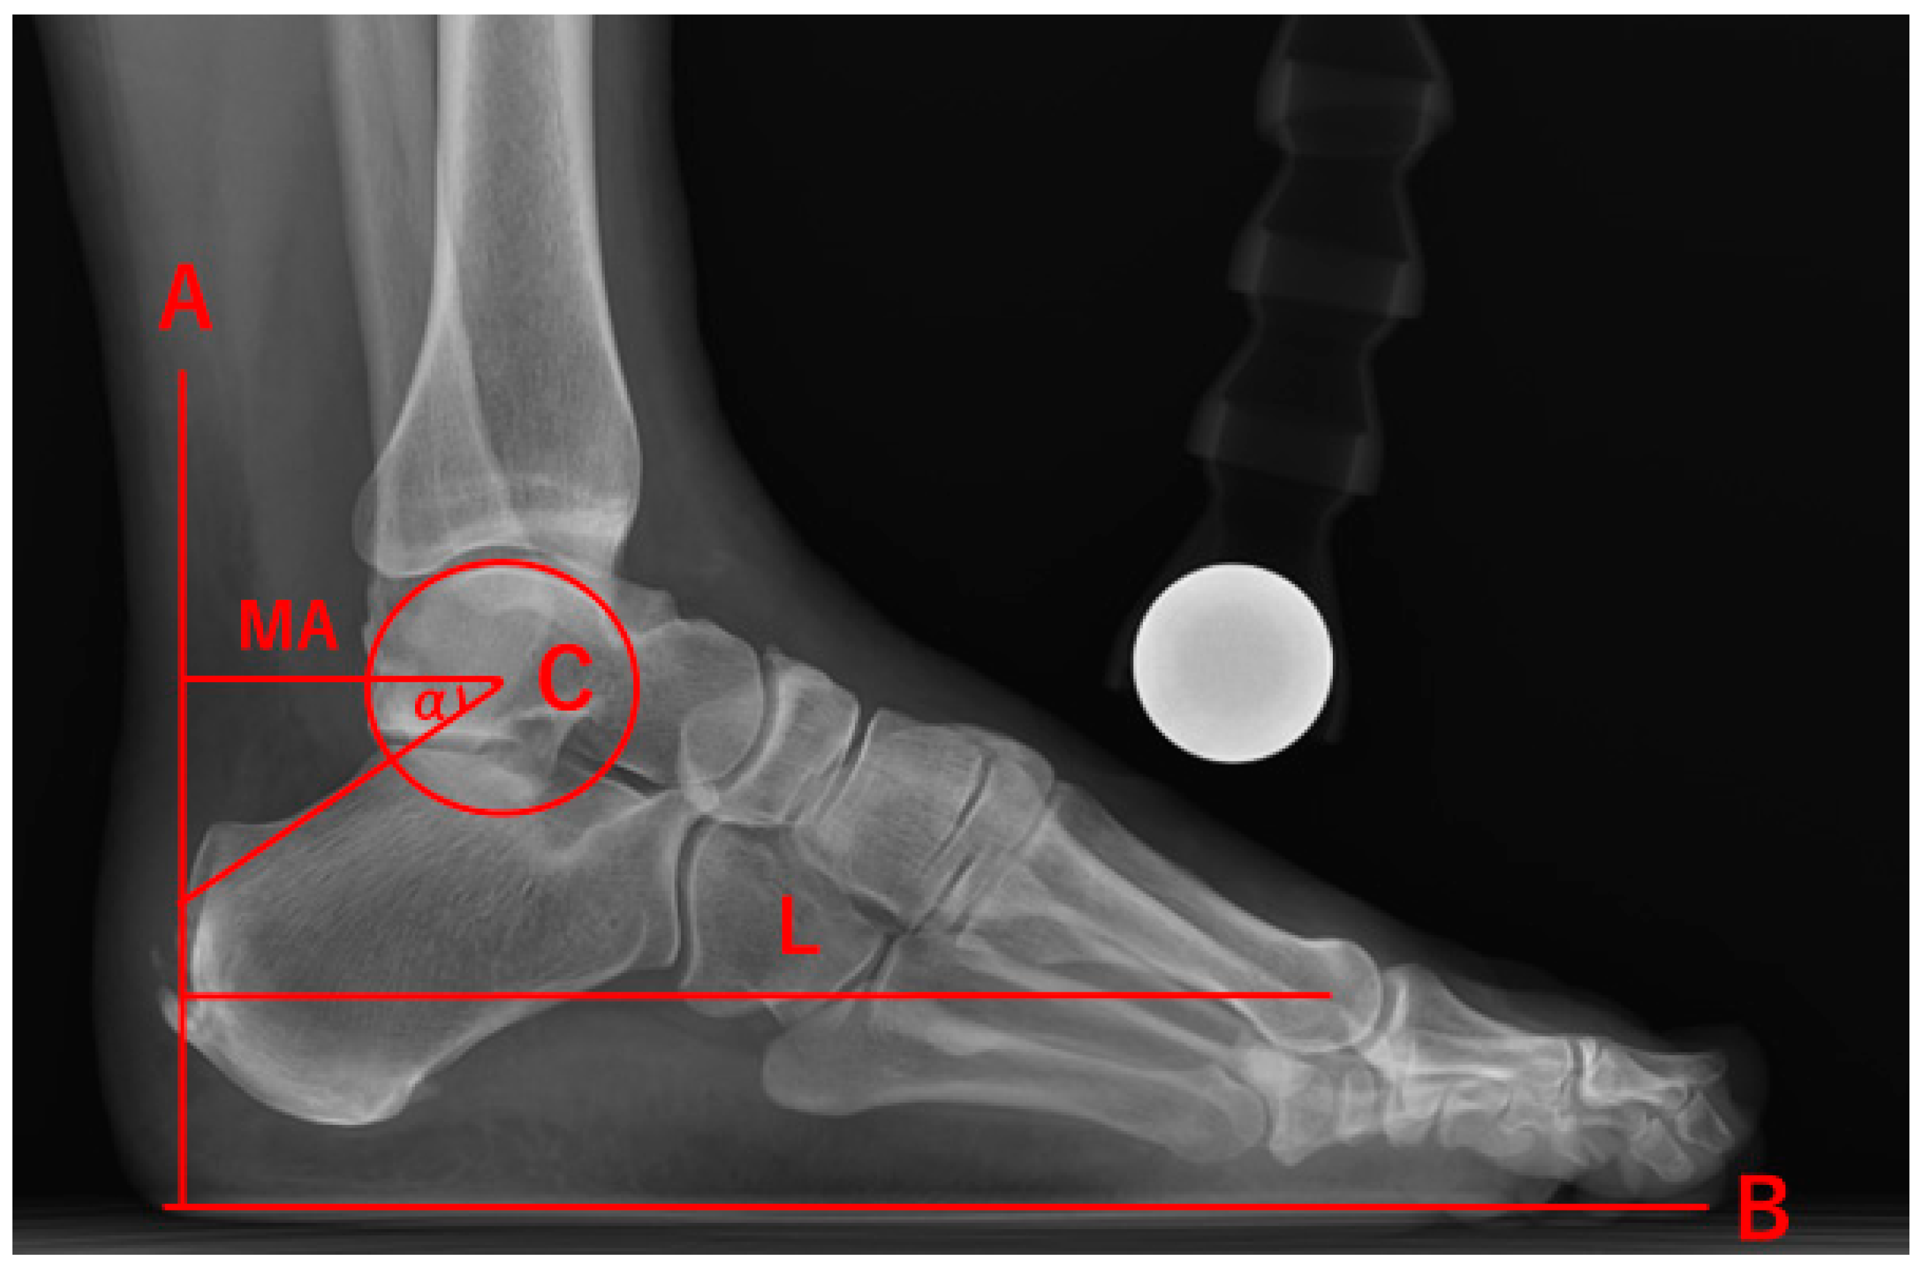
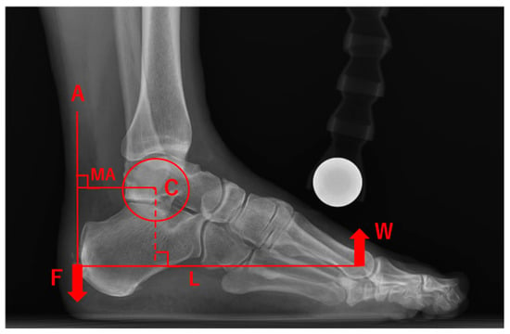
“Also, the ratio of the MA length/foot length was used to standardize the difference in foot size. Furthermore, in order to take the influence of body weight into account, the force applied to the Achilles tendon at the time of heel raise can be calculated as the rotational force around the ankle joint axis. Then, the force applied to the Achilles tendon, F, can be estimated by:
F = w × (L − MA)/MA
where w is the body weight, MA is the Achilles tendon moment arm length, and L is the length of the sole”
Figure 3. The measurement of the lateral weightbearing radiograph were (A) the centerline of the Achilles tendon insertion, (B) plantar axis, (C) the center of rotation of the ankle, (L) the length of the sole, (MA) the Achilles tendon moment arm (α). The angle between the Achilles tendon moment arm and the line connecting the insertion point and the center of rotation.
Figure 5. (A) The centerline of the Achilles tendon insertion, (C) the center of rotation of the ankle, (L) the length of the sole, and (MA) the Achilles tendon moment arm. (F) Traction force of the Achilles tendon. (W) Reaction force by body weight. We calculated F using principle of lever.
https://www.mdpi.com/2076-3417/10/19/6631

Slide 6
What is wrong with the diagram in the publication? Do the torques balance?
Publication figure
Figure 5. (A) The centerline of the Achilles tendon insertion, (C) the center of rotation of the ankle, (L) the length of the sole, and (MA) the Achilles tendon moment arm. (F) Traction force of the Achilles tendon. (W) Reaction force by body weight. We calculated F using principle of lever.

Slide 7
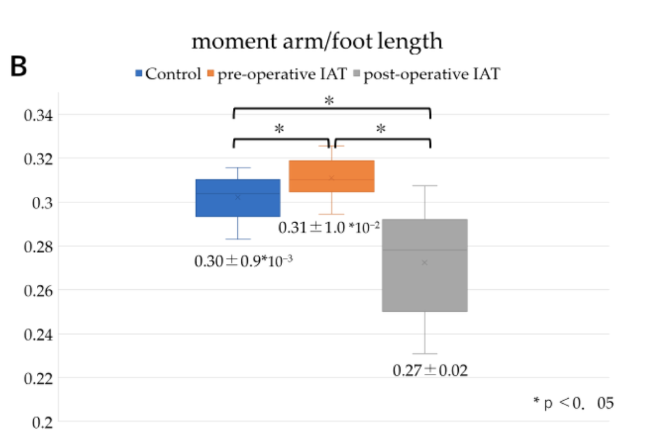
Use control data
(B): Comparison of the ratio of MA length/foot length between the control group, the preoperative IAT group, and the postoperative IAT group, showing significant differences between these groups (p < 0.05).
https://www.mdpi.com/2076-3417/10/19/6631

Slide 8
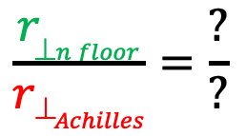
Like an upside-down seesaw
Visual estimate approach
Drag lever arms
r⊥
r⊥
Estimate lever arm ratio
1:1
2:1
3:1
4:1
5:1
$$\frac{r_{⊥n floor}}{{r⊥}_{Achilles}}=\frac{?}{?}$$
Achilles = ? W_{body}
n_{floor} = W_{body}
Drag to select
Estimate Achilles force, relative to body weight, using lever arm ratio
n_{floor} = W_{body}
Achilles = ? W_{body}
Plantar flexion
Doriflexion
Resize Achilles force vector accordingly

Slide 9
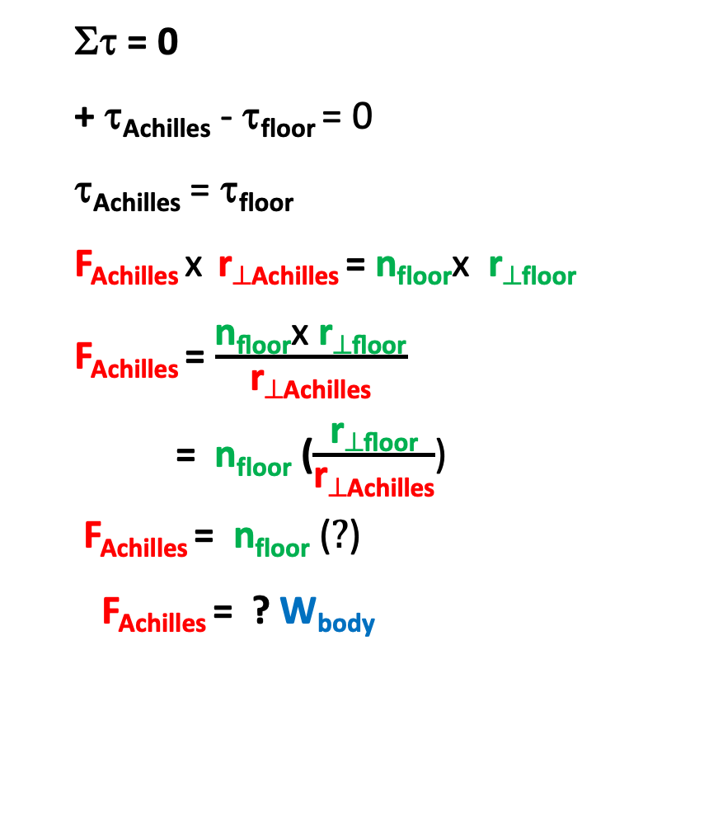
Calculation version for estimate for Achilles force
Στ = 0
+ τ_{Achilles} - τ_{floor} = 0
τ_{Achilles} = τ_{floor}
F_{Achilles} x r_{⊥Achilles} = n_{floor}x r_{⊥floor}
F_{Achilles} = $\frac{\text{n}\text{floor}\text{x} \text{r}\text{⊥}\text{floor}}{\text{r}\text{⊥}\text{Achilles}}$
= n_{floor} ($\frac{\text{r}\text{⊥}\text{floor}}{\text{r}\text{⊥}\text{Achilles}}$)
F_{Achilles} = n_{floor} ($?$)
F_{Achilles} = ? W_{body}
Achilles = ? W_{body}
r⊥
r⊥
n_{floor} = W_{body}
n_{floor} = W_{body}
Resize Achilles force vector accordingly

Slide 10
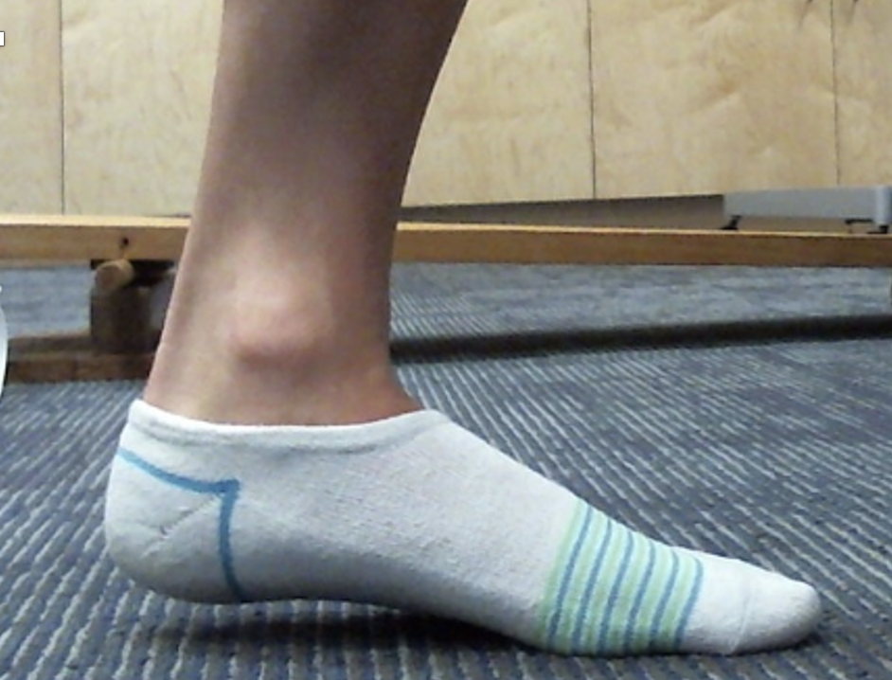
SYSTEM: foot
ΣF = 0
Achilles = ? W_{body}
Are forces on foot balanced, as shown?
Drag to select
yes
no
n_{floor} = W_{body}
If foot is not accelerating vertically ΣF_{y} = 0
If foot is not accelerating horizontally ΣF_{x} = 0
Force we need to consider – the ankle joint force

Slide 11
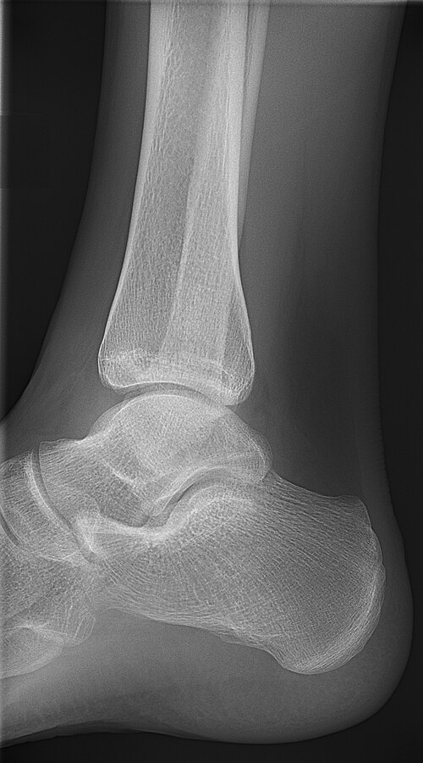
The force of the tibia on the talus and the force of the talus on the tibia are interaction force pairs
tibia
Joint force (talus on tibia)
talus
Joint force (tibia on talus)
https://commons.wikimedia.org/wiki/File:X-ray_of_normal_ankle_-_lateral.jpg\

Slide 12
Visualize the components of the muscle force
M_{x}
ΣF_{y} = 0
M_{y}
ΣF_{x} = 0
n_{floor} = W_{body}
J_{x}
Joint force
J_{y}
Draw or drag to visualize joint force components and from those the joint force
Visually estimate Joint force , relative to body weight
J_{estimate} = ? W_{body}

Slide 13
Simplistic but Usable Approximation
Achilles force and normal force are both vertical

Slide 14
Achilles = ? W_{body}
Make sure the Achilles force vectors is resized relative to the normal floor force, first.
ΣF = 0
Then estimate the direction and size of the joint force needed so forces on foot are balanced. (neglect weight of foot here, as it is small compared to the other forces)
n_{floor} = W_{body}
Joint force
Drag and resize joint force vector
Estimate size of joint force relative to body weight
J = ? W_{body}

Slide 15
ΣF = 0
Calculate estimate for joint force
ΣF = 0
+ F_{Achilles} + n_{floor} ∓ J = 0
J = ∓ F_{Achilles} ∓ n_{floor}
J = ∓ ? W_{body} ∓ W_{body}
Replace ∓ with + or -
n_{floor} = W_{body}
J = ? W_{body}
Joint force
Drag and resize joint force vector

